Slide 1

Looking for the best place for a restaurant

Slide 2
Finding a place for a restaurant provide a competitive advantage
In a highly competitive environment every bit of advantage is vital
Just having a good business is often not enough
Having geospatial data of Moscow districts can provide that advantage

Slide 3
Data acquisition and cleaning
Get districts and their geospatial coordinates from gis-lab.info
Get venue information from Foursquare API
In total we get 145 districts, 390 unique venue categories and 8789 venues for those districts
Cleaned data contains venues and names of the districts, as well as their geospatial data

Slide 4
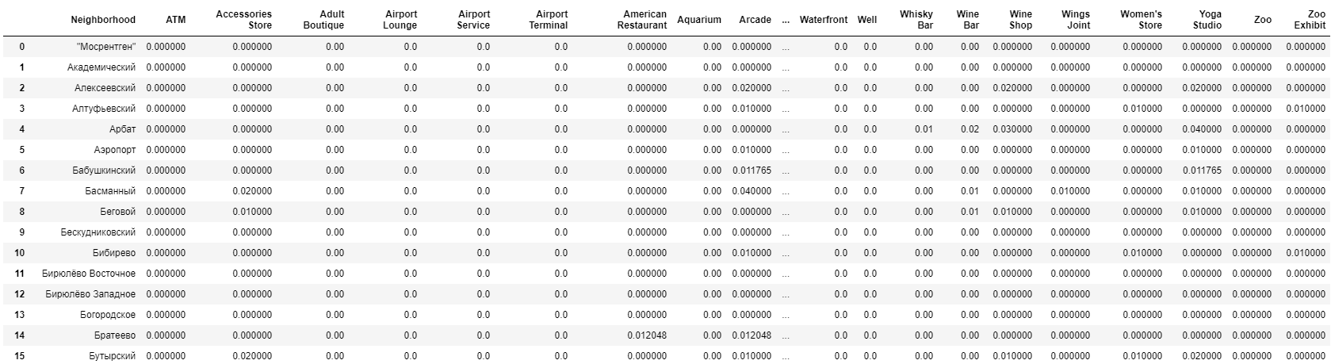
One hot encoding and mean values
One hot encode our dataset
Convert the values into means (they show appearance frequency) for clustering

Slide 5
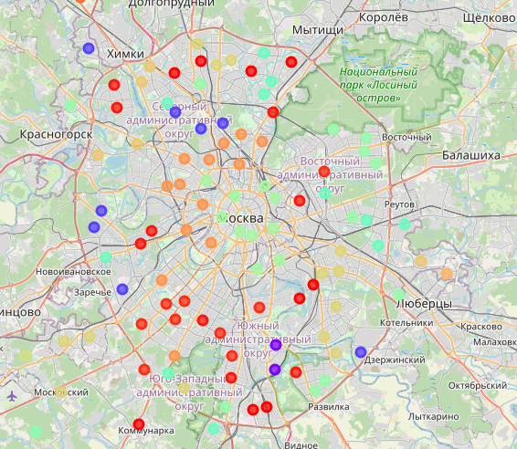
Map our clusters
We map our clusters for better visual representation

Slide 6
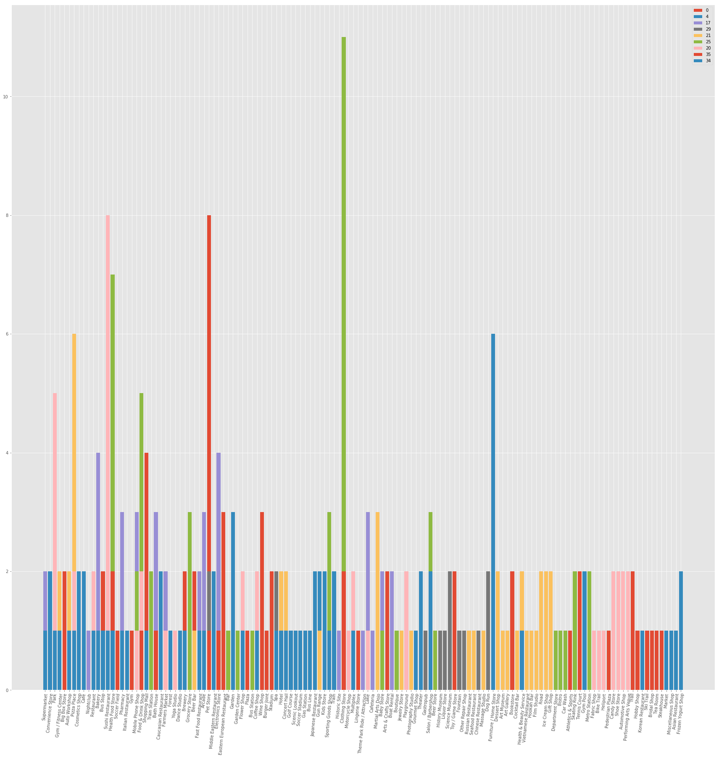
Get a stacked plot for top 10 venues
Here we can see venue distribution of each cluster

Slide 7
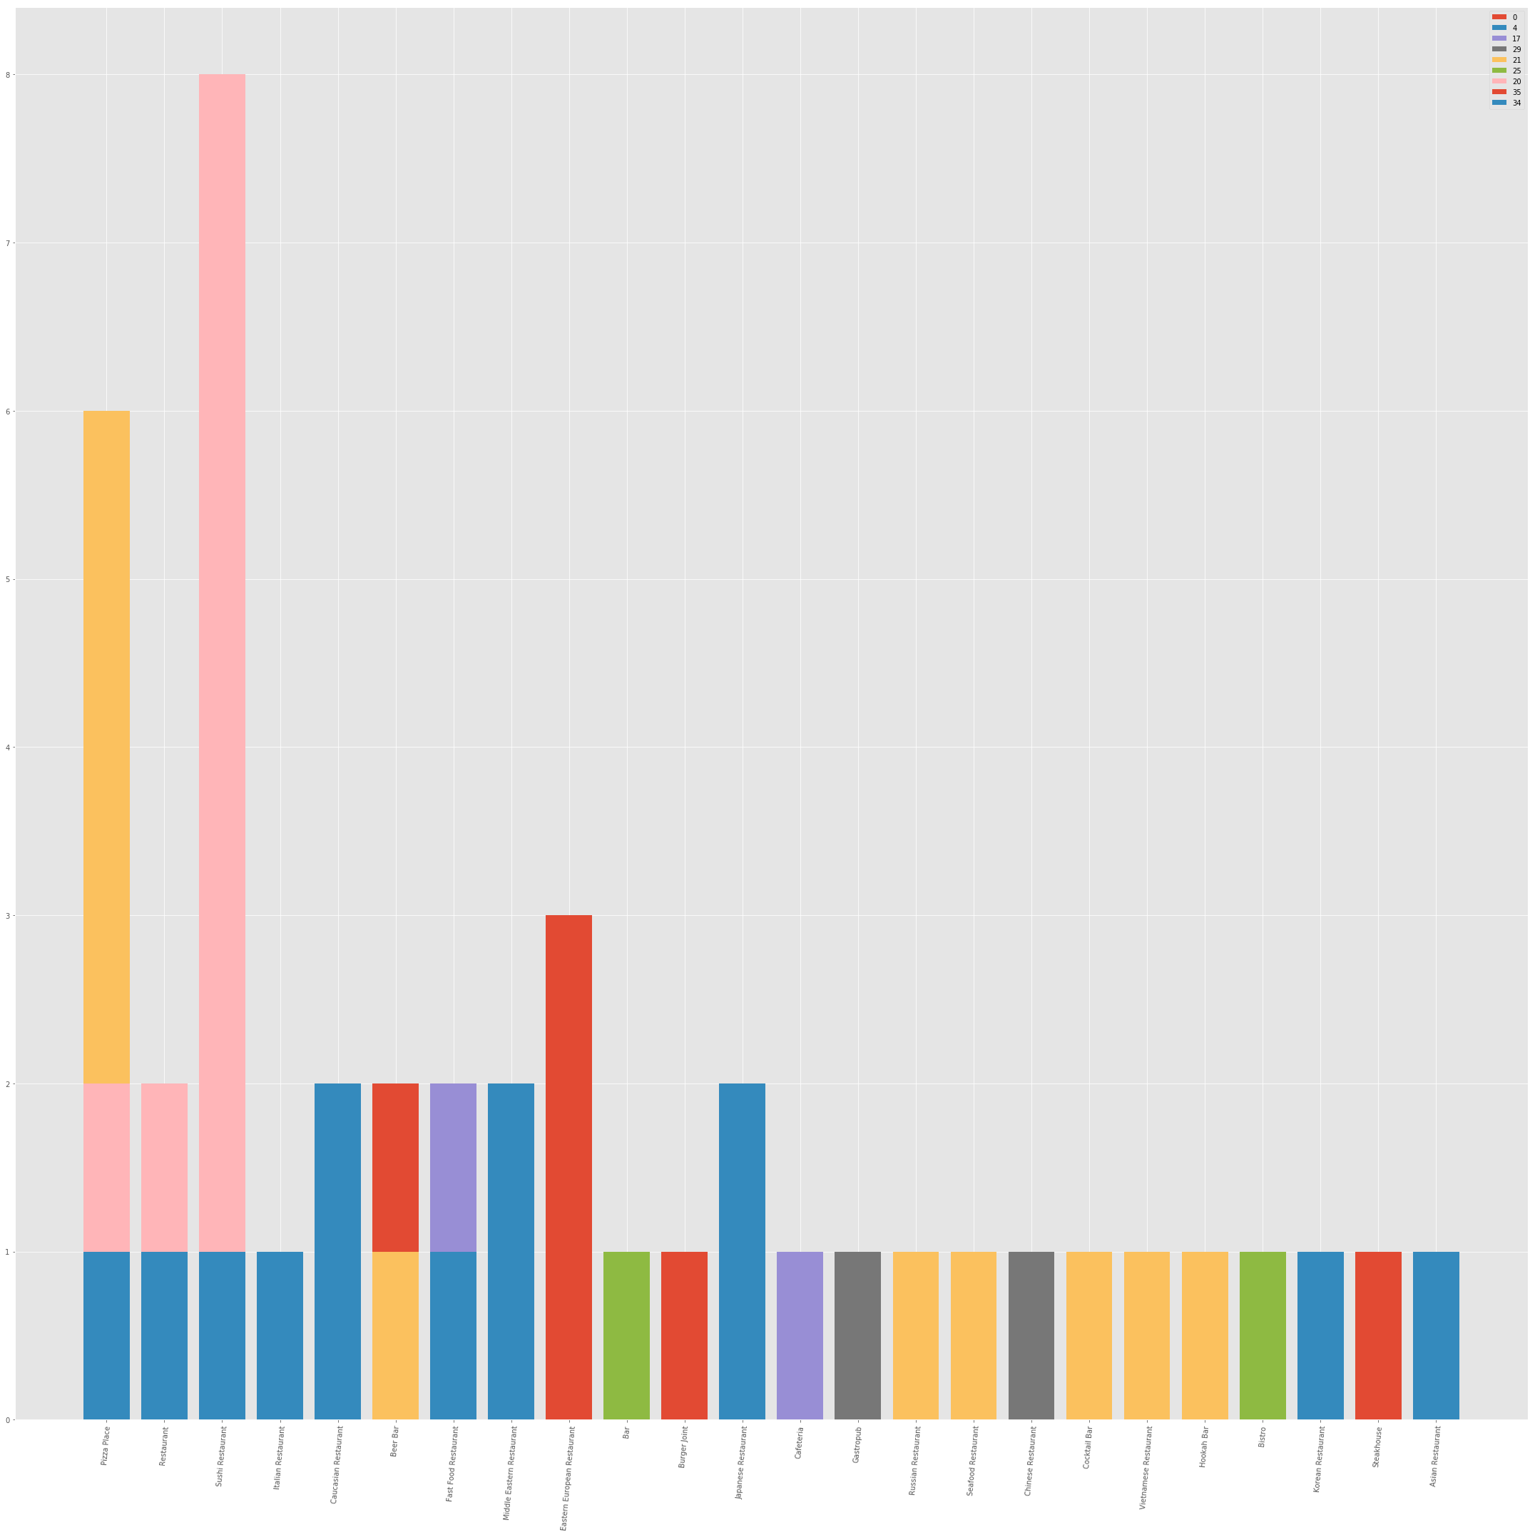
Plot top 10 food-related venues
Here we can see food venues distribution

Slide 8
Finding the most fitting clusters
We use the data to find clusters that have the most amount of data AND the least amount of food-related venues
After analysis, we come to a conclusion that the best fits are clusters 0, 17 and 25.
Cluster 17 has the most amount of data and few food-related venues, we will look into it further

Slide 9
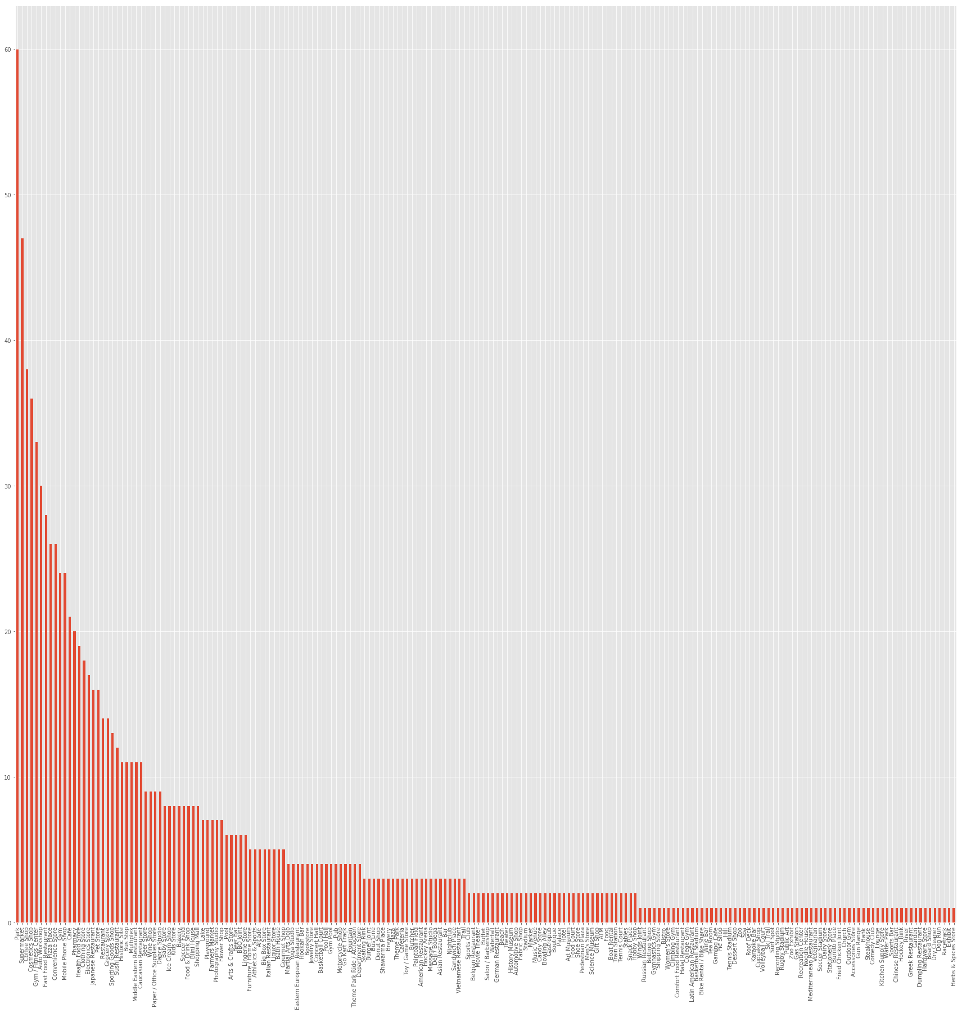
Inspecting the cluster
We can inspect what venues are the most popular in the cluster, and see what people are like in this cluster

Slide 10
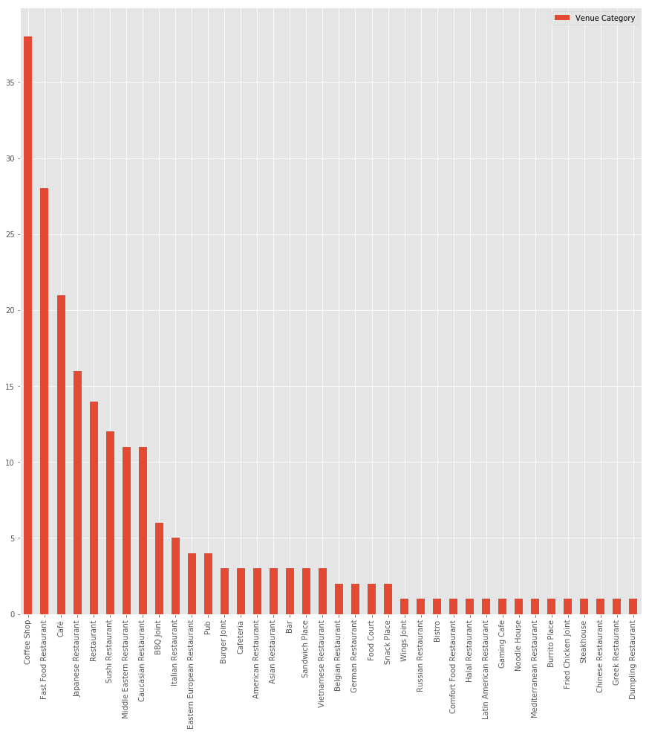
Inspecting all of the food venues in the cluster
This graph shows us how many food venues are in this cluster, what are the most popular once, and which are lacking

Slide 11
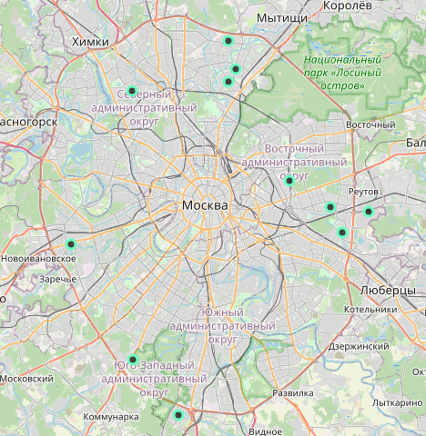
Mapping our cluster
This is the map of our cluster, which allows for selecting a place for a restaurant

Slide 12
Conclusion
Based on the data we got the best places for a food venue
Accuracy of the model has room for improvement
Foursquare data is not complete since the free version was used

